Slide 1


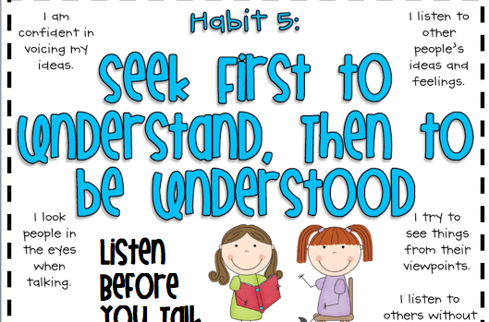


SEEK FIRST TO UNDERSTAND , THEN TO BE UNDERSTOOD
HABIT # 5

Slide 2
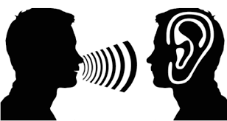
COMMUNICATION
Most important skill in life for effective interpersonal relations
We think of communication as speaking, reading and writing
But the most important part of communication is LISTENING!
Do we have the training for effective listening? To deeply understand others?

Slide 3
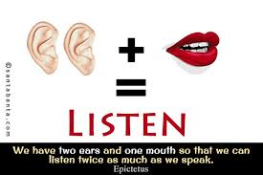
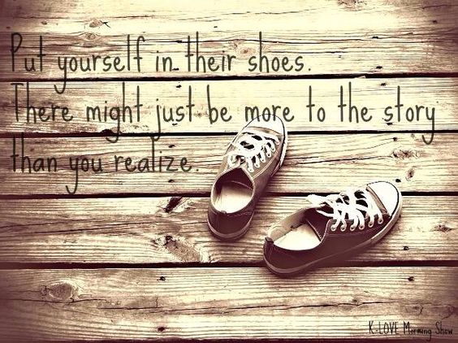
People don’t care how much you know until they know how much you care!

Slide 4
AUTOBIOGRAPHICAL LISTENING ‘often people listen in order to reply, and their responses are based more on their own experience and interpretation than what the other person is saying’.
Autobiographical or Self-Centred responses:
Evaluate: We agree or disagree. You are jumping to decisions without fully understanding the situation, which robs the person of the emotional space she/he needs to process a problem.
Probe: You ask questions based on your interpretations and experiences, and not based on what the person is saying. Probing often creates communication barriers.
Advise: You offer advice on what to do and how to fix the problem, prescribing before diagnosing.
Interpret: You try to figure out the person’s motives and behaviors based on how you would act in that situation; this is different than trying to understand the other person’s perspective.

Slide 5


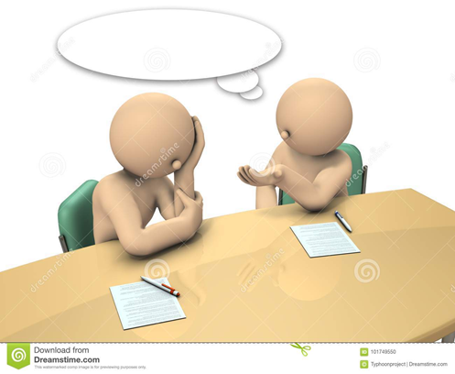

AUTOBIOGRAPHICAL RESPONSES
EVALUATE
PROBE
ADVISE
INTERPRET
Autobiographical Listening can take a toll on our relationships.
Work towards listening empathically.

Slide 6
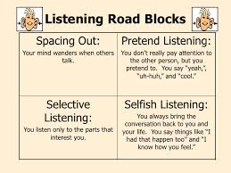
FIVE TYPES OF LISTENING
×Spacing Out: not really listening at all
× Pretending: humming along but not really following
× Selective listening: hearing what you want to hear
× Attentive listening: paying attention to the words
✓Empathic listening: intending to understand what other is trying to communicate

Slide 7
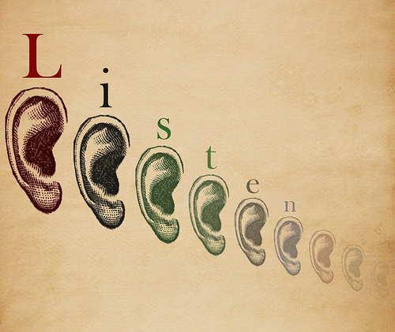
Most people do not listen with the intent to understand; they listen with the intent to reply!
Seek first to understand’;
The key to good judgement is effective understanding.
You must first understand the problem before you can effectively address the solution
You must first understand others well before you start wanting them to understand you
Before the problem comes up, before you to try to evaluate and advice, before you try to present your own views…..
be an empathic listener!!
it is a powerful habit of effective interdependence

Slide 8

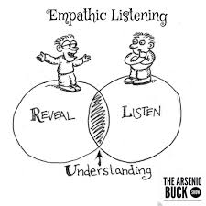
EMPATHIC LISTENING ……the only form of true listening
Listen with your eyes, ears and heart
Stand in the speaker’s shoe; look at things from his/her perspective
Is not about agreeing with the speaker but understanding what message the speaker is trying to convey
Not to show sympathy but to show empathy

Slide 9

EMPATHETIC LISTENING - it’s all about the speaker not the listener
Listen carefully to the speaker’s messages – both verbal and non-verbal
Display an open, caring posture
Consider the speaker’s emotional state
Don’t ask a lot of questions which would give impression that you are grilling the speaker
Act like a mirror and reflect back what the speaker is saying and feeling

Slide 10

Why be an empathic listener?
Builds trust and respect
Enables the speaker to feel free and helps to release emotions
Reduces tensions
Creates an environment conducive for a strong relationship

Slide 11
……Then to be understood REFLECTION
Exercise the basic effective listening skills (Empathic listening) and then share your feedback.
Give Constructive feedback
Ask yourself Will this feedback really help the person or am I doing it just to suit myself and fix them?
Send “I” messages instead of “You” messages
“You have done the wrong thing”. ×
“I am concerned that you may have done the wrong thing”✓
“You are so self-centred” ×
“I feel that you have been acting selfish lately” ✓

Slide 12
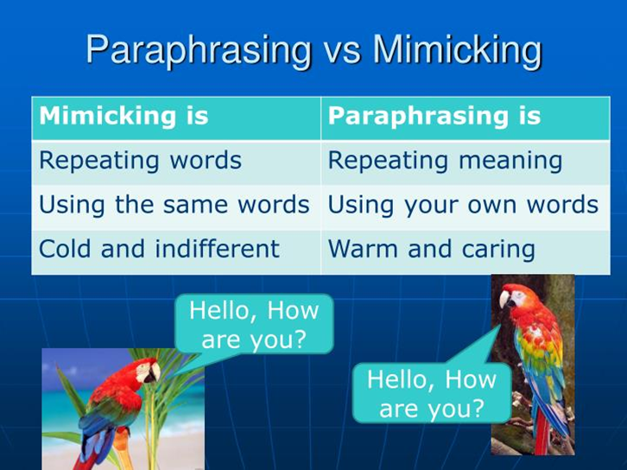
PRACTICE PARAPHRASING
REPHRASE OR PARAPHRASE
Simply repeat the meaning of what you understand in your own words.
Start by saying
“I can see that you are feeling….”
“So what you are saying is……...”
“As I see it you felt that………...”

Slide 13
BARRIERS OF LISTENING
In the process of listening any snag/hitch can be considered a barrier
These barriers affect the listening process
Broadly barriers are caused by the speaker, listener or location
Physical barriers: Noise, excessive cheers, whispers, phone or intercom interruptions etc.
Physiological barriers: Illness, hearing impairment, tiredness, poor eyesight etc.
Psychological barriers: Anxiety, anger, frustrations, distractions, other emotions
Cultural barriers: Accent, slangs, different choice of words, pronunciation etc
Linguistic barriers: Language, Jargon, complex words or sentences
Content barriers: Too much or too little knowledge of content, not interested, difficult to understand, repetitive content, overload of message
Environmental barriers: Uncomfortable seating, Dim or bright light, Too cold or too hot, poor ventilation etc.

Slide 14

CONCLUSION
You will be understood if you have achieved the following:
You have taken the time to truly understand the other person’s frame of reference.
The other person trusts you based on your previous interactions.
You present a good logical argument.
Being understood is quite simple, but it’s rooted in a deep understanding of the other person.

